Slide 1
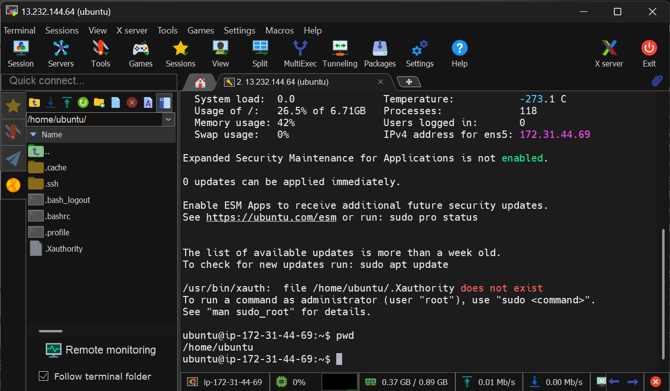
Using MobaXterm app

Slide 2
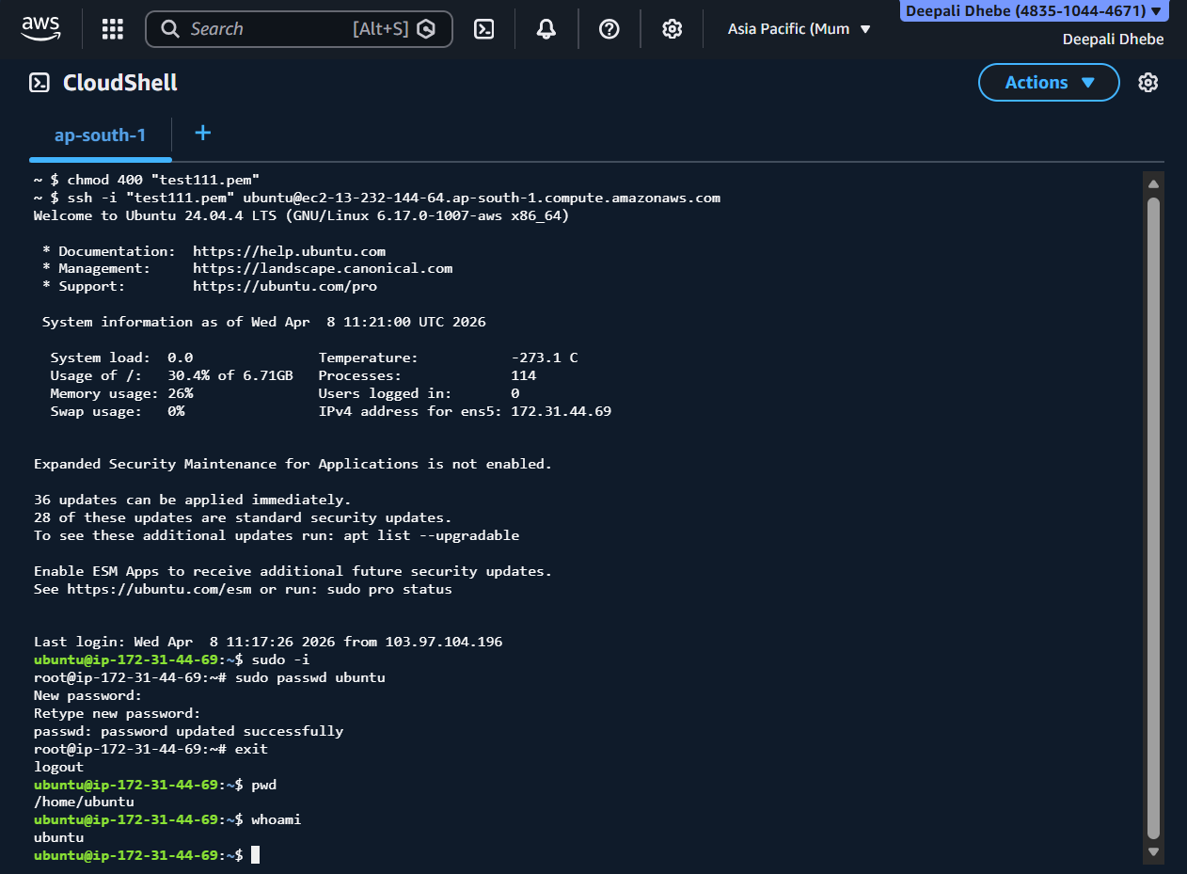
Using AWS CloudShell

Slide 3
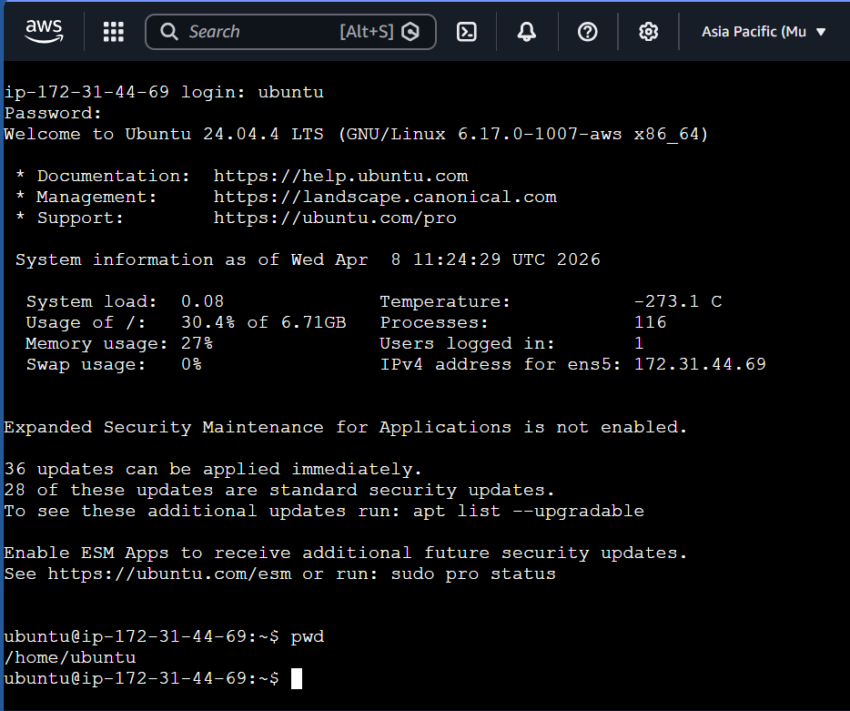
Using EC2 Serial Console

